Slide 1
Chapter 9: Data Types
2023

Slide 2
Chapter 9: Data Types
Content:
Integer data types
Decimal data types
Date data types
Character data types

Slide 3
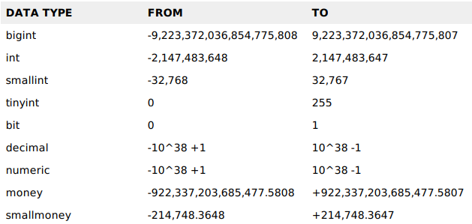
DATA TYPES
A data type is an attribute associated with a piece of data that tells a computer system how to interpret its value.
Understanding data types ensures that data is collected in the preferred format and the value of each property is as expected.
Here are some data types you might have come across or will come across in the course:

Slide 4
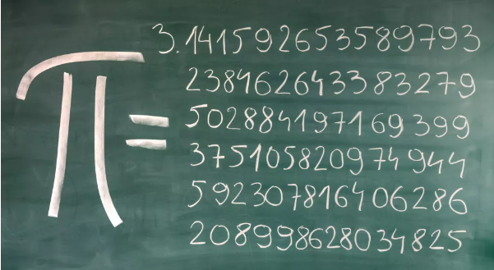

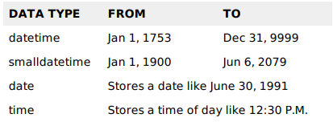
DATA TYPES
Real numbers are numbers that include both rational and irrational numbers. Rational numbers such as integers (-2, 0, 1), fractions(1/2, 2.5) and irrational numbers such as √3, π(22/7), etc., are all real numbers

Slide 5
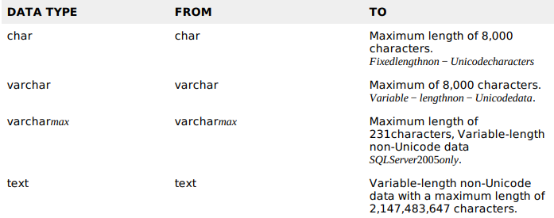

DATA TYPES

Slide 6
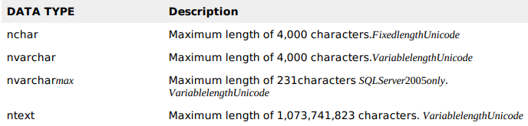
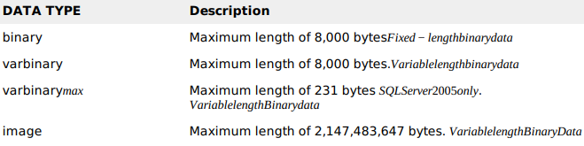

DATA TYPES

Slide 7
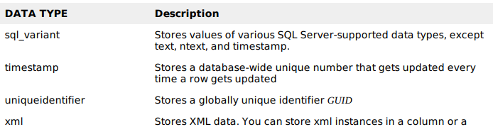
DATA TYPES

Slide 8
Data types
Create an EMP database
Create employees table with the following columns first names, last name , email address, Hire date , Salary, Employment, date of birth and notes. Consider the following:
The characters for firstname and lastname should be 25 or less without using adding constraint to datatype
Email address should not be greater than 100 characters
Hire date should be only be date
Employment contract which can be either permanent fixed-term casual zero hours or independent contract
Ensure the notes column is an appropriate data type
Each employee earns a salary of max 6 digits.
Employee
Notes:
CREATE TABLE employees (
first_name varchar(25),
last_name varchar(25),
email varchar(100),
hire_date date,
salary decimal(6,2),
employment varchar(25),
date_of_birth date,
notes nvarchar(max)
);

